Slide 1
Using computer simulation models to investigate the molecular mechanisms of ageing
Carole Proctor

Slide 2
The Ageing Process
Age-related Frailty, Disability, and Disease
Accumulation of Cellular Defects
Healthy nutrition
Repair
Random Molecular Damage
Poor nutrition
Stress
(Adapted from Kirkwood, Cell 2005)
Notes:
4

Slide 3
The complexity of ageing
Mc Auley et al., 2017, Biosc Rep, 37(1)

Slide 4
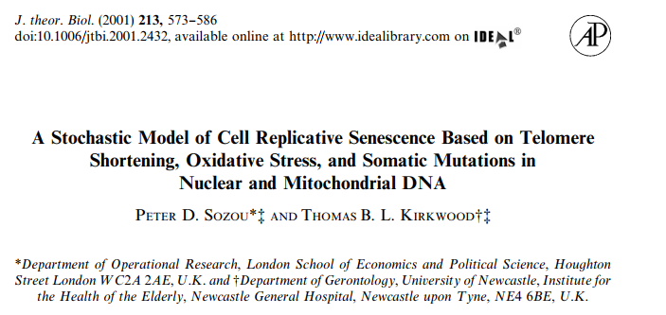
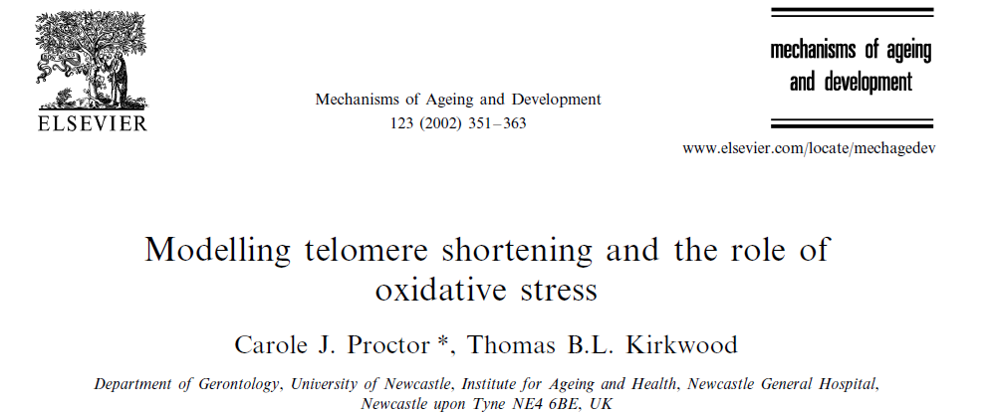
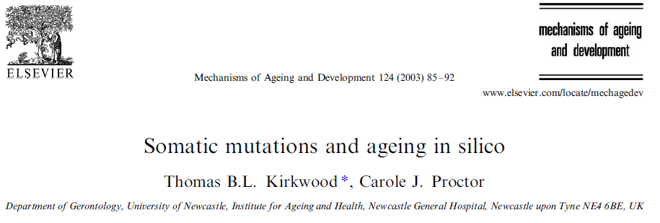
Early models of ageing mechanisms
Models encoded in C, Java or Mathematica
Difficult to share, modify or integrate
Difficult to engage experimental scientists

Slide 5
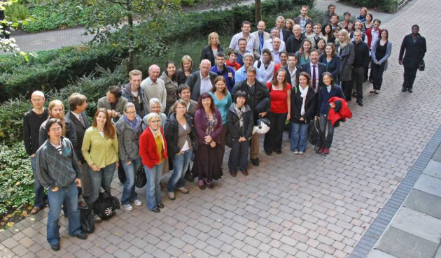
Centre for Integrated Systems Biology of Ageing and Nutrition
Aim: to advance understanding of the complex mechanisms underpinning the ageing process and how these are affected by nutrition.
Multidisciplinary team of experimental biologists, computer scientists, mathematical modellers and statisticians.

Slide 6
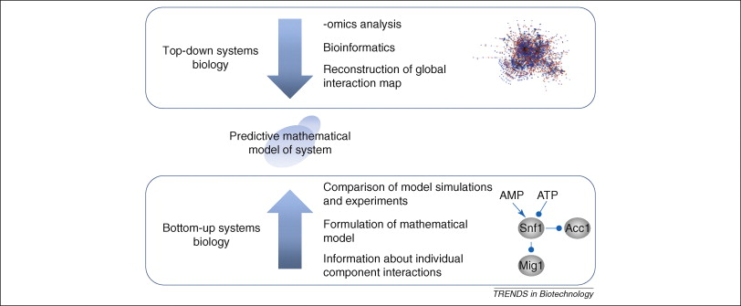
Systems biology approaches
Figure from:
Trends in Biotechnology 2008 26, 584-590DOI: (10.1016/j.tibtech.2008.07.008)
Copyright © 2008 Elsevier Ltd Terms and Conditions
Notes:
Illustration of different approaches to systems biology. In top-down systems biology, high-throughput experimental data are generated, and these are used to reconstruct pathways or co-regulated modules. These modules can then form the basis for more detailed studies, where the dynamics of the individual components are quantified, and this can lead to a mathematical model describing the system. In bottom-up systems biology, the pathway is reconstructed based on studies of the interaction of individual components. This reconstructed pathway forms the basis for setting up a kinetic model that can be used to simulate the dynamic operation of the pathway. Through comparison of model simulations with experimental data, it is possible to evaluate both the model structure and the kinetics of the individual process.

Slide 7
www.sbml.org

Slide 8
SBML software tools
Model construction
Import/export SBML
Simulation
Model analysis
Parameter estimation

Slide 9
https://www.ebi.ac.uk/biomodels-main/

Slide 10
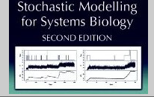
SBML-shorthand
@model:2.1.0=ProteinHomeostasis
@units
substance=item
@compartments
cell=1.0
@species
cell:Hsp90=0.0s
cell:Hsf1_Hsp90=500.0s
cell:Hsf1=0.0s
cell:MisP=0.0s
cell:Hsp90_MisP=0.0s
cell:NatP=6000.0s
cell:AggP=0.0s
⁞
@parameters
ksynprotein=0.01
kmisfold=0.002
kbinHsp90MisP=0.1
⁞
@reactions
@r=proteinSynthesis
Source -> NatP
ksynprotein * Source
@r=Hsp90MisPBinding
MisP+Hsp90 -> Hsp90_MisP
kbinHsp90MisP * MisP * Hsp90
⁞
Python tool converts shorthand code into full SBML
Darren Wilkinson
Newcastle University
https://www.staff.ncl.ac.uk/d.j.wilkinson/software/sbml-sh/

Slide 11
Computer simulation models
Deterministic
ODE models
ODEs created from SBML
Continuous
Assumes high copy number
Average behaviour
Stochastic
Gillespie algorithm
Random effects
Discrete
Suitable for low copy number
Repeat simulations
Time consuming to simulate

Slide 12
Gillespie algorithm for stochastic simulation (direct method)
0) Initialization: Initialize the number of molecules in the system, parameter values, and random number generators.
1) Calculate: Each reaction rate and expected time to next reaction.
2) Monte Carlo Step: Generate random numbers based on 1 to determine:
time to the next reaction
which reaction occurs
3) Update: Increase the time step by the randomly generated time in Step 2. Update the molecule count based on the reaction that occurred.
4) Iterate: Go back to Step 1 unless the number of reactants is zero or the simulation time has been exceeded.
(Gillespie DT, 1977)

Slide 13
SBML models of ageing
Protein homeostasis
DNA damage
Protein aggregation

Slide 14
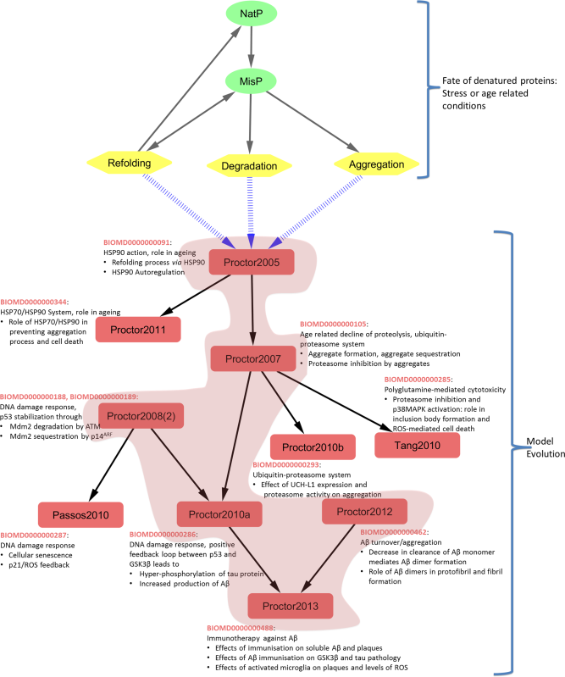
Hierarchy of SBML models
CPT: Pharmacometrics & Systems Pharmacology Volume 4, Issue 2, pages 55-68, 26 FEB 2015 DOI: 10.1002/psp4.3 http://onlinelibrary.wiley.com/doi/10.1002/psp4.3/full#psp43-fig-0006

Slide 15
Models of protein aggregation

Slide 16
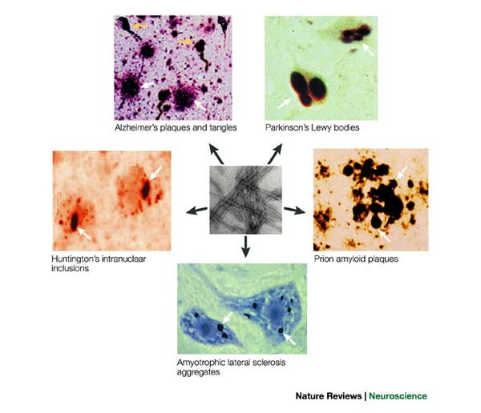
Cerebral aggregates in neurodegenerative diseases
Two distinct types of aggregates in Alzheimer’s disease
Soto C, 2003 Nature Reviews Neuroscience, 4, 49-60

Slide 17
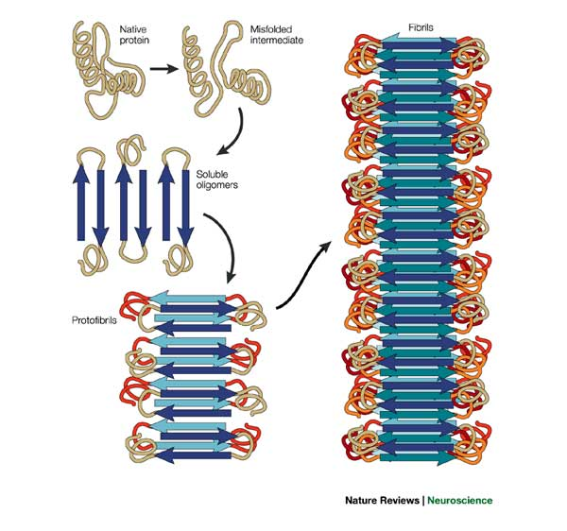
Pathway leading to protein misfolding and aggregation
Soto, 2003

Slide 18
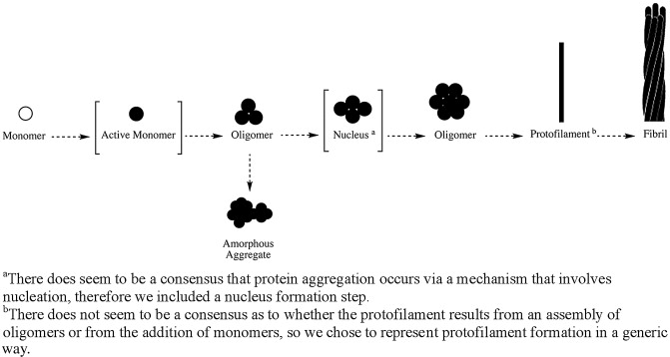
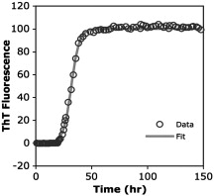
Schematic representation of the general pathway for formation of protein fibrils
reversible
irreversible
An example of α-synuclein data published by Fink (2006), and fit to the Finke-Watzky 2-step mechanism:
A → B (slow rate);
A+B → 2B (autocatalytic, fast rate)
Morris et al., 2009, Biochimica et Biophysica Acta, 174:375-397

Slide 19
Mechanisms of Alzheimer’s disease (AD)
Amyloid cascade hypothesis
(Selkoe 1991, Hardy & Higgins 1992)
plaques
tangles
Controversy concerning:
order of events
relative importance of plaques and tangles
http://www.dw.com/en/searching-for-treatment-for-alzheimers/a-15716477
neuronal
death
dementia

Slide 20
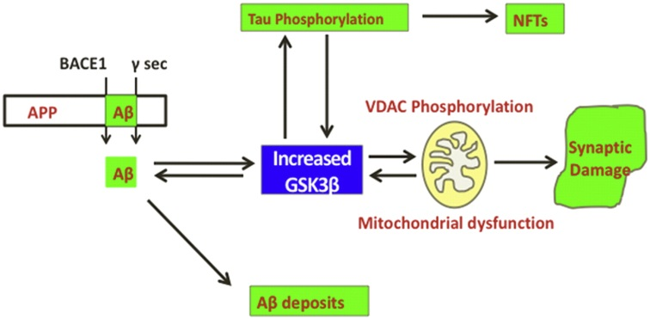
(tangles)
GSK3 = glycogen synthase kinase-3
Reddy,2013, Biochimica & Biophysica Acta, 1832: 1913-21

Slide 21
In this study, p53 was mainly in the nucleus and tau was in the cytoskeleton suggesting indirect effects
So the effect is via:
either a transcriptional target of p53
or a kinase which is downstream of p53 in the signalling pathway (GSK3β?)

Slide 22
Is there a link between GSK3β, p53, Aβ and tau in AD?
Proctor & Gray, Mol. Neur. 2010, 5:7

Slide 23
Model construction
1. p53 turnover and interaction with GSK3β
p53
Mdm2
Proctor & Gray, Mol. Neur. 2010, 5:7

Slide 24
Model construction
2. Aβ production and aggregation; the DNA damage response
Proctor & Gray, Mol. Neur. 2010, 5:7

Slide 25
Model construction
3. Tau turnover and aggregation
Proctor & Gray, Mol. Neur. 2010, 5:7

Slide 26
Simulation results: unstressed cells
p53
Mdm2
Gsk3β-p53
Aβ plaque
Tau tangle
DNA damage
A-D Individual runs
E Average of 100 runs
F Deterministic solution
Proctor & Gray, Mol. Neur. 2010

Slide 27
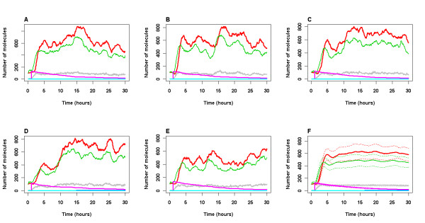
Model output for stressed conditions
p53
Mdm2
Gsk3β-p53
Aβ plaque
Tau tangle
DNA damage
A-E Individual runs
F Average of 100 runs
An event to mimic irradiation was triggered at t=1h
Proctor & Gray, Mol. Neur. 2010

Slide 28
Stochastic events may initiate the aggregation process
p53
Mdm2
Gsk3β-p53
Aβ plaque
Tau tangle
DNA damage
A-E Individual runs
F Average of 100 runs
Proctor & Gray, Mol. Neur. 2010

Slide 29
Using the model to test interventions
Immunization with Aβ leads to less plaques and also less tau tangles.
It works by:
increasing Aβ clearance
disaggregating plaques
activation of glia cells to engulf and degrade plaques
But why are tau tangles reduced?

Slide 30
Modelling Aβ immunization
Aβ
AβPlaque
$$∅$$
1
AntiAβ
2
Glia
$$∅$$
Glia are partially activated by plaques and fully activated by AntiAβ
Looked at effect of adding antibodies at different time points
Proctor et al., 2013, PLoS ONE 8:e73631

Slide 31
Simulating Aβ passive immunization
Soluble Aβ
Aβ plaque
Phospho-tau
Tau tangle
Activated glia
No intervention
Day 0
Day 4
Day 8
Day 0 + Day 7
Active immunization
Proctor et al., 2013, PLoS ONE 8:e73631

Slide 32
New hypothesis of AD involving p53 and GSK3β
Proctor et al., 2013, PLoS ONE 8:e73631

Slide 33
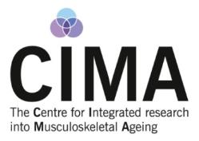
Models of musculoskeletal ageing

Slide 34
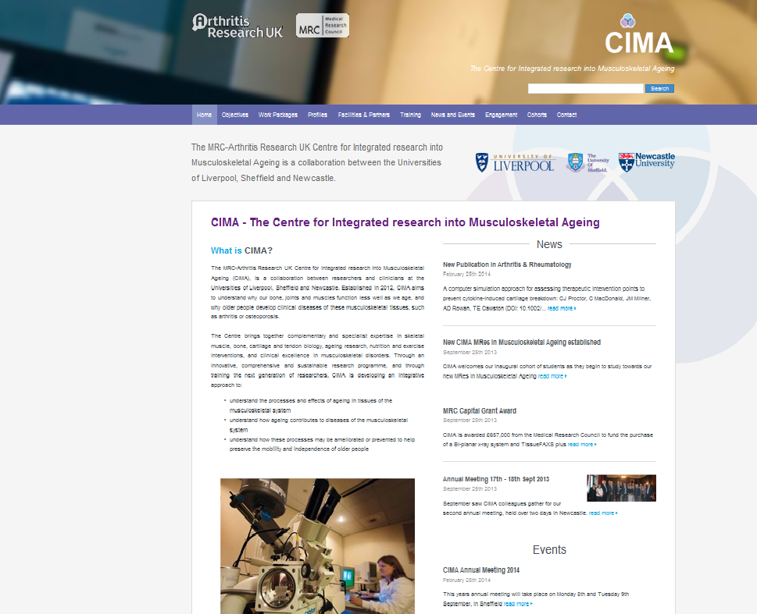
Aim:
To develop an integrated approach to understanding the processes and effects of ageing in tissues of the musculoskeletal system.
http://www.cimauk.org/

Slide 35
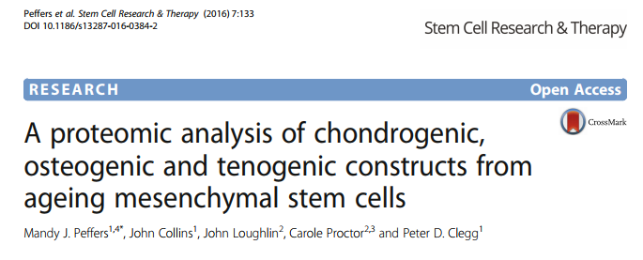
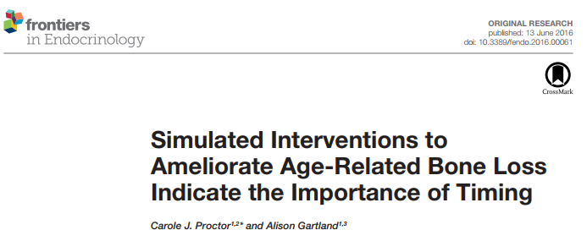
Example projects

Slide 36
MicroRNAs (miRNAs) regulate gene transcription
miRNA
mRNA
Protein translation
mRNA degradation

Slide 37
miRNAs in feedback/feedforward gene regulatory circuits (network motifs)
Positive feedback
TF
miR
Negative feedback
TF
miR
Positive feedforward
Coherent
TF
miR
Trgt
Incoherent
TF
miR
Trgt

Slide 38
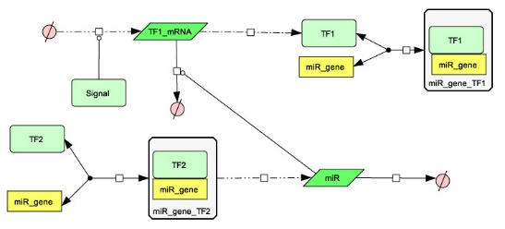
Dynamic model of positive feedback
TF1
miR
Upregulation of TF1
Inhibition of miR
Inhibition of TF1 by miR
Turnover of miR
Proctor CJ & Smith GR, 2017 PLoS One 12: e0187568
Notes:
Positive feedback – deterministic model

Slide 39
Simulating a positive feedback loop
Stochastic
TF1
miR
Signal
H
Deterministic
Proctor CJ & Smith GR, 2017 PLoS One 12: e0187568
Notes:
Positive feedback, A-D stoc model 24342 ind runs ; E stoc mode 50 runs F) Det model

Slide 40
miR-140 in ageing cartilage
ADAMTS5
IL1
Smad3
miR140
NFκB
Hdac4
MMP13
Sox9
Runx2
Proctor CJ & Smith GR, 2017 PLoS One 12: e0187568
Notes:
Diagram of combined model (simplified) – made portrait figure

Slide 41
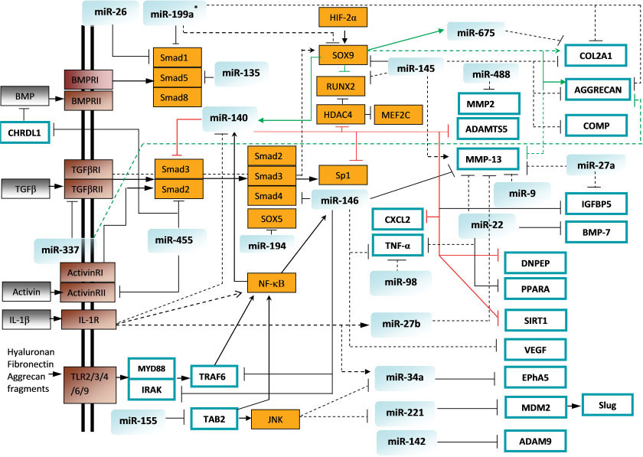
miRNAs in cartilage and osteoarthritis (OA)
Many studies have focussed on miR-140 leading to possible bias
Need to use more unbiased approaches
Linh et al., Arthritis & Rheumatism, 2013

Slide 42
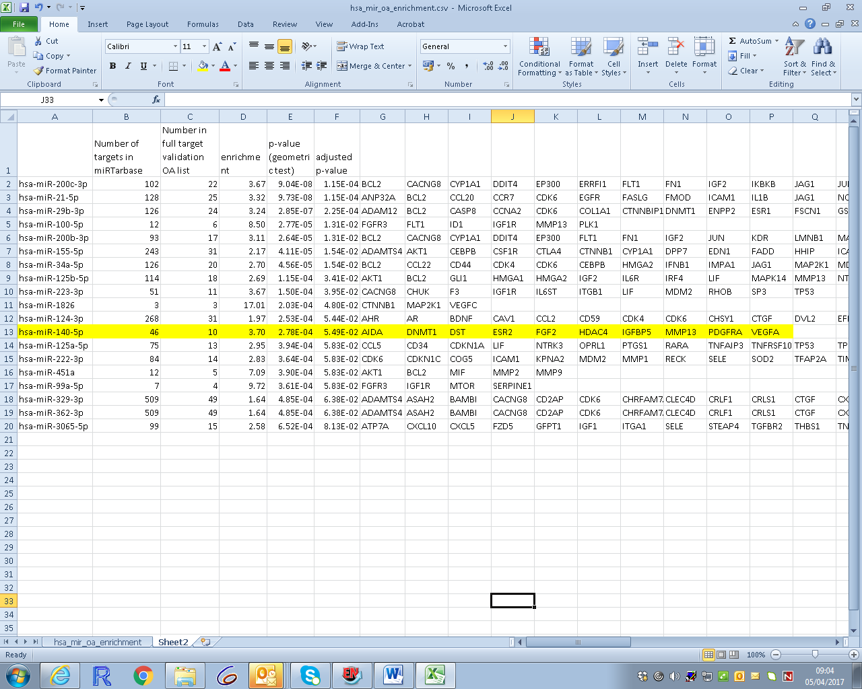
Showing top 20 out of 106 miRs with OA-related targets
Graham Smith
Bioinformatics Support Unit Newcastle University
Proctor CJ & Smith GR, 2017 PLoS One 12: e0187568

Slide 43
XIAP
VEGFA
IKBKB
BCL2
FLT1
JAG1
NTRK2
VEGFA
Apoptosis
ZEB1
NOTCH1
Inflammation
Chondrocyte hypertrophy
Oxidative stress
miR-200c-3p
ERRFI1
TUBB3
Cytoskelelton
SP1
FN1
TIMP2
DNMT3A
DNMT3B
VEGFA
ECM maintenance
Angiogenesis
Metabolism
Proctor CJ & Smith GR, 2017 PLoS One 12: e0187568

Slide 44
Future work and challenges
Validation of novel miRNAs in context of OA
Construct integrative networks of miRNAs
Models for different tissues: bone, cartilage, muscle and tendon
Integrate top-down and bottom-up approaches
Make use of public databases, however:
not always up to date
may contain unreliable data

Slide 45
Thanks to:
Newcastle:
Tom Kirkwood
Tim Cawston
Daryl Shanley
Graham Smith
Darren Wilkinson
Drew Rowan
David Young
Matt Barter
Liverpool:
Katarzyna Goljanek-Whysall
Ana Soriano-Arroquia
Rachel McCormick
Mandy Peffers
Peter Clegg
Sheffield:
Alison Gartland
Ottawa:
Doug Gray
Ian Lorimer
Southampton:
Delphine Boche
James Nicoll
COPASI team
Biomodels team

